Slide 1
Adaptive Cards
Adaptive Cards & Actionable Messages

Slide 2

Adaptive Cards & Actionable Messages
Adaptive Card Overview
Card Reference and Visualizer
Actionable Messages with Adaptive Cards

Slide 3

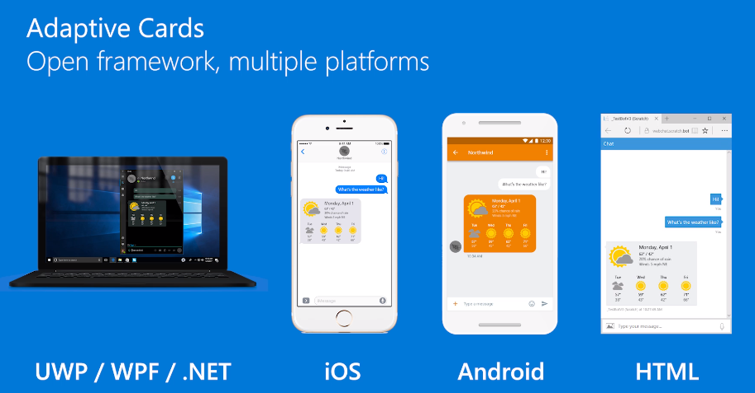
Adaptive Cards
https://adaptivecards.io
Notes:
Use the MessageCard Playground to view samples and design your own cards

Slide 4
Adaptive Cards
Goals
Portable - To any app, device, and UI framework
Open - Libraries and schema are open source and shared
Low cost - Easy to define, easy to consume
Expressive - Targeted at the long tail of content that developers want to produce
Purely declarative - No code is needed or allowed
Automatically styled - To the Host application UX and brand guidelines

Slide 5
Adaptive Card schema
Property | Examples
Cards | Adaptive Cards
Card Elements | TextBlock, Image
Containers | ColumnSet, FactSet, ImageSet
Actions | OpenUrl, Submit, ShowCard
Inputs | Text, Number, Date/Time, Toggle, Choice
Notes:
All text fields in the card support markdown.

Slide 6
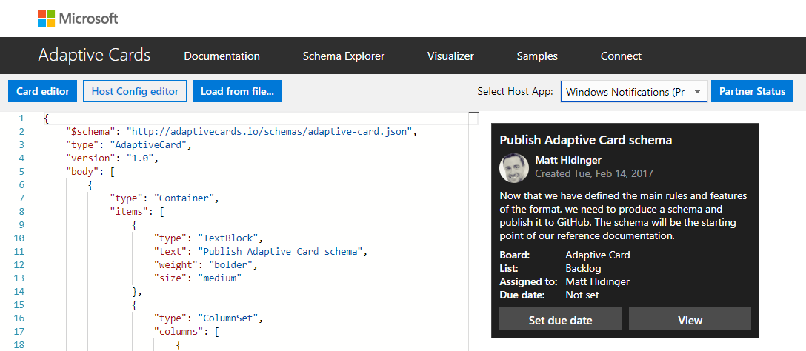
Adaptive Card Visualizer
https://adaptivecards.io/visualizer
Notes:
Use the Adaptive Card Visualize to view samples in the various host applications (from Microsoft)

Slide 7
Outlook-specific Adaptive Card properties and features
Outlook introduces a set of additional Adaptive Card properties and features for use in the context of Actionable Messages.
Input.Time is not supported
If you include an Input.Time element in your card, it will not be displayed. If you need to allow users to input a time, use an Input.Text instead and validate its value server-side.
Differences in Action elements
Action.Submit is not supported
Additional Action types
Action.Http
Action.InvokeAddInCommand
Action.DisplayMessageForm
Action.ToggleVisibility
Action.Transaction
Additional Properties
AdaptiveCard element properties for security & display in Outlook
Column formatting
Container alignment/background

Slide 8
Demo

Slide 9

Summary

Slide 10
Thank you

